Slide 1
The Children’s Institute: The Day School
Investment Opportunities

Slide 2
Overview
A Description
Outside the Classroom
Investing

Slide 3
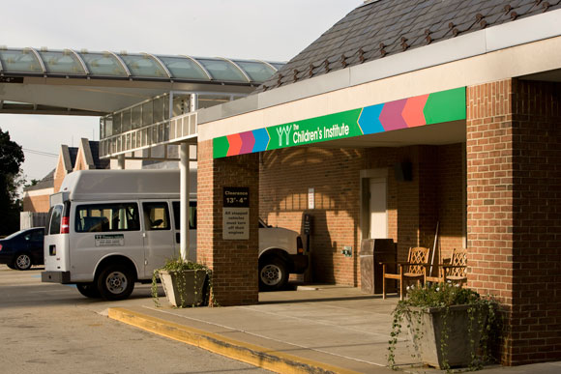
A Description: General Information
Approved Private School licensed by Pennsylvania Bureau of Private Academic Schools and Pennsylvania Department of Education, Bureau of Special Education
Educates students ages 5-21 with multiple disabilities or autism
Values
Compassion
Integrity
Excellence
Innovation
Teamwork and Collaboration
Fun

Slide 4
A Description: The Students
Autism
Defined: Range of neurodevelopment disorders causing social and communication difficulties and restrictive behaviors
Multiple Disabilities
Defined: Two or more combinations of physical, cognitive and/or communicative impairments causing extreme educational problems (mental retardation-blindness, mental retardation-orthopedic impairment )
http://www.projectidealonline.org/multipleDisabilities.php
http://www.ninds.nih.gov/disorders/autism/detail_autism.htm

Slide 5
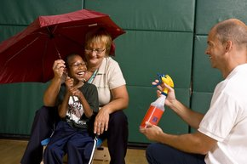
A Description: Services
Speech Therapy
Augmentative communication
Occupational therapy
Physical therapy
School nursing services
Psychological services
Social work services
Visual consultation
Dietary services
GymBop- combination of music and gym class to create motivation for therapies
Applied Behavior Analysis- improvement of social behavior to increase the well-being of autistic students

Slide 6
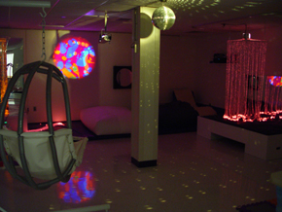
A Description: Facilities
Gymnasium
Swimming pool
Library
Sensory Room
Multipurpose Room
Classrooms for students with autism:
No florescent lights
Designed to eliminate distractions and annoyances

Slide 7
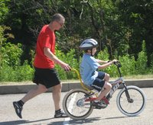
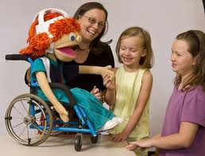
Outside the Classroom
Growing Families Through Adoption
Lose the Training Wheels Camp
Grand Rounds
Camp Success

Slide 8
Investing: Why Give?
Support children with special needs
Serve your community
Grow your business
Receive tax deductions and other benefits

Slide 9
Investing: Gifts
Cash Gifts
Tax deductible
Matching Gifts
Employers match or double employees’ donations
In-kind Donations
Tangible item or product to use or sell

Slide 10
Investing: Cause Marketing
Grow your company while supporting the Day School
An “effective way” to raise profits and help the community*
Become known and appreciated for your help
Acknowledgment in Amazing Kids newsletter
Naming opportunities
*(see 2008 Cone Cause Evolution Study, 2008 Edelman goodpurpose™ Consumer Study, 2008 Barkley Cause Survey, 2009 Cone, Inc. Consumer Environmental Survey, 2009 Edelman goodpurpose™ Consumer Study, 2009 Barkley Cause Survey).

Slide 11
Investing: Sponsorship
Recognition on signs, product samplings and logo display at events
Opportunities
Growing Families Through Adoption
Lose the Training Wheels Camp
Grand Rounds
Camp Success
Kids on the Block

Slide 12
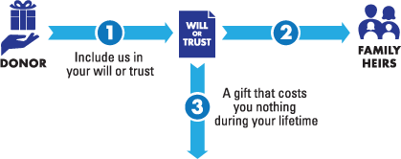
Investing: Other Gifts
Anyone Can Give
Give You Income
Protect Your Assets

Slide 13
Summary
The Children’s Institute: Day School…
Educates students with autism and multiple disabilities in a modern school with caring professionals
Contributes to the community
Needs your help to continue supporting these special students and their communities!

